Slide 1
Topics to be Covered:
Polymorphism
Upcasting
Dynamic method dispatch

Slide 2
Polymorphism

Slide 3
Polymorphism
Polymorphism in Java is a concept by which we can perform a single action in different ways.
Polymorphism is derived from 2 Greek words: poly and morphs. The word "poly" means many and "morphs" means forms. So polymorphism means many forms.
There are two types of polymorphism in Java: compile-time polymorphism and runtime polymorphism.
We can perform polymorphism in java by method overloading and method overriding.
If you overload a static method in Java, it is an example of compile time polymorphism. Here, we will focus on runtime polymorphism in java.

Slide 4
Upcasting

Slide 5
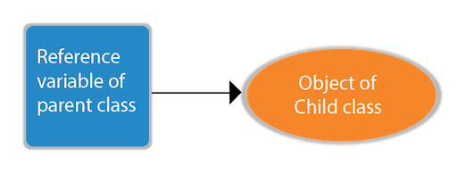
Upcasting
If the reference variable of the Parent class refers to the object of the Child class, it is known as upcasting. For example:
Consider the following declaration :
class A // Parent Class
{
}
class B extends A // Child Class
{
}
A obj=new B(); //Upcasting
Here, obj is the reference variable of parent class A, which is referring to the object of child class B.

Slide 6
Dynamic Method Dispatch

Slide 7
Dynamic Method Dispatch
Runtime polymorphism or Dynamic Method Dispatch is a process in which a call to an overridden method is resolved at runtime rather than compile-time.
In this process, an overridden method is called through the reference variable of a superclass.
The determination of the method to be called is based on the object being referred to by the reference variable.
class Bike
{
void run() { System.out.println(“Running"); }
}
class Splendor extends Bike
{
void run(){ System.out.println(“Running safely with 60km"); }
public static void main(String args[])
{
Bike b = new Splendor();//upcasting
b.run();
}
}
We are calling the overridden method run() by the reference variable of Parent class.
Since it refers to the subclass object and subclass method overrides the Parent class method, the subclass method is invoked at runtime.
Since method invocation is determined by the JVM, it is known as runtime polymorphism.
Output:
Running safely with 60km

Slide 8
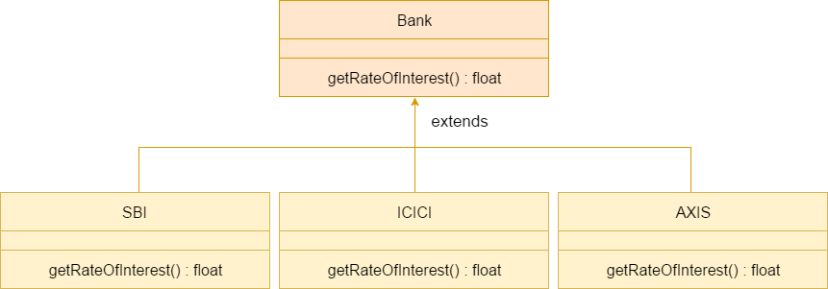
Dynamic Method Dispatch : Bank Example
Consider a scenario where Bank is a class that provides a method to get the rate of interest.
However, the rate of interest may differ according to banks. For example, SBI, ICICI, and AXIS banks are providing 8.4%, 7.3%, and 9.7% rate of interest.

Slide 9
Dynamic Method Dispatch : Bank Example
class Bank
{
float getRateOfInterest()
{
return 0;
}
}
class SBI extends Bank
{
float getRateOfInterest()
{
return 8.4f;
}
}
class ICICI extends Bank
{
float getRateOfInterest()
{
return 7.3f;
}
}
class AXIS extends Bank
{
float getRateOfInterest()
{
return 9.7f;
}
}
class TestPoly1
{
public static void main(String args[])
{
Bank b;
b=new SBI(); // Referring to object of SBI Class
System.out.println("SBI Rate of Interest: "+b.getRateOfInterest());
b=new ICICI(); // Referring to object of ICICI class
System.out.println("ICICI Rate of Interest: "+b.getRateOfInterest()); b=new AXIS(); // Referring to object of AXIS class
System.out.println("AXIS Rate of Interest: "+b.getRateOfInterest()); }
}

Slide 10
Dynamic Method Dispatch : Shape Example
class Shape
{
void draw()
{
System.out.println(“Drawing...");
}
}
class Rectangle extends Shape
{
void draw()
{
System.out.println(“Drawing rectangle...");
}
}
class Circle extends Shape
{
void draw()
{
System.out.println(“Drawing circle...");
}
}
class TestPoly2
{
public static void main(String args[])
{
Shape s;
s=new Rectangle();
s.draw();
s=new Circle();
s.draw();
}
}
Output:
Drawing rectangle
Drawing circle

Slide 11
Thank You

